Slide 1
Edge to Cloud Protocol
The protocols that are used to transfer hypertext between two computers is known as HyperText Transfer Protocol.
HTTP provides standard between a web browser and web server to establish communication. It is set of rules for transferring data from one computer to another. Data such as text, images, and other multimedia files are shared on the World Wide Web. Whenever a web user opens their web browser, user indirectly uses HTTP. It is an application protocol which is used for distributed, collaborative, hypermdia information systems

Slide 2
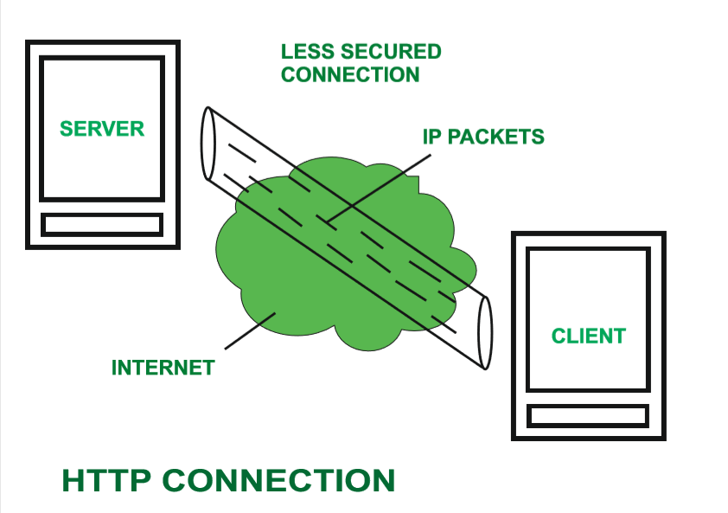

Slide 3
How does HTTP work
First of all, whenever we want to open any website then first we open web browser after that we will type URL of that website (e.g., www.facebook.com ). This URL is now sent to Domain Name Server (DNS). Then DNS first check records for this URL in their database, then DNS will return IP address to web browser corresponding to this URL. Now browser is able to sent request to actual server.
After server sends data to client, connection will be closed. If we want something else from server we should have to re-establish connection between client and server

Slide 4
Characteristics of HTTP
Server processes a request, which is raised by client and also server and client knows each other only during current request and response period.
Any type of content can be exchanged as long as server and client are compatible with it.
Once data is exchanged then servers and client are no more connected with each other.
It is a request and response protocol based on client and server requirements.
It is connection less protocol because after connection is closed, server does not remember anything about client and client does not remember anything about server.
It is stateless protocol because both client and server does not expecting anything from each other but they are still able to communicate.

Slide 5
Advantages
Memory usage and CPU usage are low because of less simultaneous connections.
Since there are few TCP connections hence network congestion are less.
Since handshaking is done at initial connection stage, then latency is reduced because there is no further need of handshaking for subsequent requests.
The error can be reports without closing connection.
HTTP allows HTTP pipe-lining of request or response.

Slide 6
Disadvantages
HTTP requires high power to establish communication and transfer data.
HTTP is less secure, because it does not uses any encryption method like https use TLS to encrypt normal http requests and response.
HTTP is not optimized for cellular phone and it is too gabby.
HTTP does not offer genuine exchange of data because it is less secure.
Client does not close connection until it receives complete data from server and hence server needs to wait for data completion and cannot be available for other clients during this time

Slide 7
WebSocket
WebSocket is bidirectional, a full-duplex protocol that is used in the same scenario of client-server communication, unlike HTTP it starts from ws:// or wss://. It is a stateful protocol, which means the connection between client and server will keep alive until it is terminated by either party (client or server). After closing the connection by either of the client and server, the connection is terminated from both ends
This is how after client-server handshaking, the client-server decide on a new connection to keep it alive, this new connection will be known as WebSocket. Once the communication link establishment and the connection are opened, message exchange will take place in bidirectional mode until connection persists between client-server. If anyone of them (client-server) dies or decide to close the connection is closed by both of the party.

Slide 8
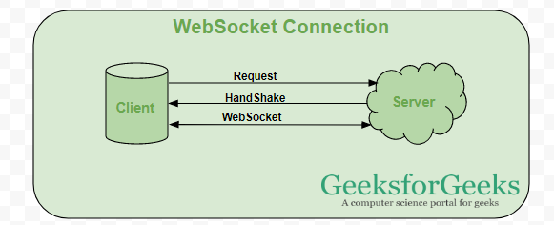

Slide 9
When to use websocket
Real-time web application: Real-time web application uses a web socket to show the data at the client end, which is continuously being sent by the backend server. In WebSocket, data is continuously pushed/transmitted into the same connection which is already open, that is why WebSocket is faster and improves the application performance.
For e.g. in a trading website or bitcoin trading, for displaying the price fluctuation and movement data is continuously pushed by the backend server to the client end by using a WebSocket channel.
Gaming application: In a Gaming application, you might focus on that, data is continuously received by the server, and without refreshing the UI, it will take effect on the screen, UI gets automatically refreshed without even establishing the new connection, so it is very helpful in a Gaming application.
Chat application: Chat applications use WebSockets to establish the connection only once for exchange, publishing, and broadcasting the message among the subscribers. It reuses the same WebSocket connection, for sending and receiving the message and for one-to-one message transfer.

Slide 10
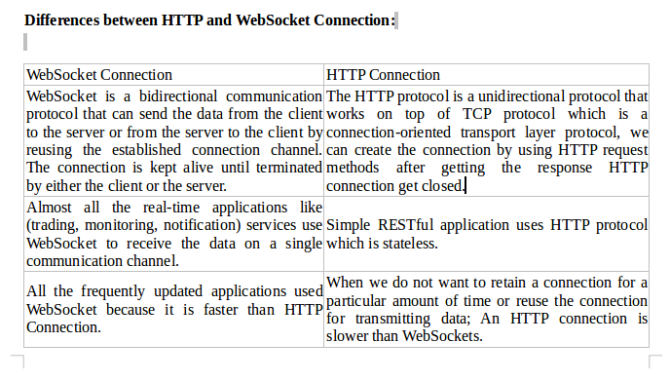

Slide 11
Message Queuing Telemetry Transport (MQTT)
MQTT is a standards-based messaging protocol, or set of rules, used for machine-to-machine communication. Smart sensors, wearables, and other Internet of Things (IoT) devices typically have to transmit and receive data over a resource-constrained network with limited bandwidth. These IoT devices use MQTT for data transmission, as it is easy to implement and can communicate IoT data efficiently. MQTT supports messaging between devices to the cloud and the cloud to the device.

Slide 12
Why MQTT protocol is important
Reliable
Many IoT devices connect over unreliable cellular networks with low bandwidth and high latency. MQTT has built-in features that reduce the time the IoT device takes to reconnect with the cloud. It also defines three different quality-of-service levels to ensure reliability for IoT use cases— at most once (0), at least once (1), and exactly once (2).
Secure
MQTT makes it easy for developers to encrypt messages and authenticate devices and users using modern authentication protocols, such as OAuth, TLS1.3, Customer Managed Certificates, and more.
Well-supported
Several languages like Python have extensive support for MQTT protocol implementation. Hence, developers can quickly implement it with minimal coding in any type of application.

Slide 13
Why MQTT protocol is important
Lightweight and efficient
MQTT implementation on the IoT device requires minimal resources, so it can even be used on small microcontrollers. For example, a minimal MQTT control message can be as little as two data bytes. MQTT message headers are also small so that you can optimize network bandwidth.
Scalable
MQTT implementation requires a minimal amount of code that consumes very little power in operations. The protocol also has built-in features to support communication with a large number of IoT devices. Hence, you can implement the MQTT protocol to connect with millions of these devices.

Slide 14
What is the principle behind MQTT
The MQTT protocol works on the principles of the publish/subscribe model. In traditional network communication, clients and servers communicate with each other directly. The clients request resources or data from the server, then the server processes and sends back a response. However, MQTT uses a publish/subscribe pattern to decouple the message sender (publisher) from the message receiver (subscriber). Instead, a third component, called a message broker, handles the communication between publishers and subscribers. The broker’s job is to filter all incoming messages from publishers and distribute them correctly to subscribers. The broker decouples the publishers and subscribers as below:
Space decoupling
The publisher and subscriber are not aware of each other’s network location and do not exchange information such as IP addresses or port numbers.
Time decoupling
The publisher and subscriber don’t run or have network connectivity at the same time.
Synchronization decoupling
Both publishers and subscribers can send or receive messages without interrupting each other. For example, the subscriber does not have to wait for the publisher to send a message.

Slide 15
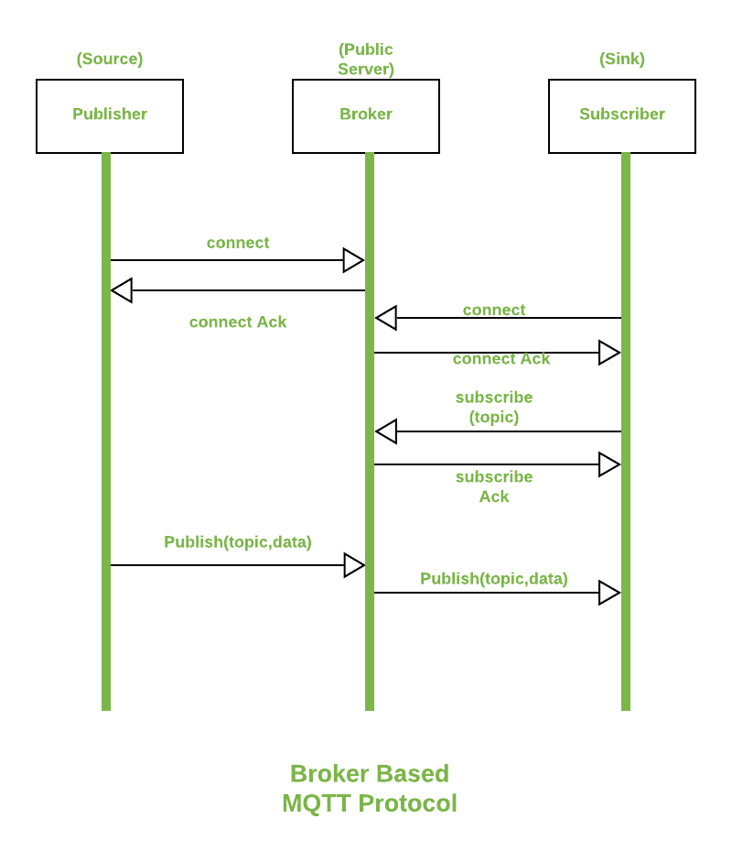

Slide 16
What are MQTT components
MQTT implements the publish/subscribe model by defining clients and brokers as below.
MQTT client
An MQTT client is any device from a server to a microcontroller that runs an MQTT library. If the client is sending messages, it acts as a publisher, and if it is receiving messages, it acts as a receiver. Basically, any device that communicates using MQTT over a network can be called an MQTT client device.
MQTT broker
The MQTT broker is the backend system which coordinates messages between the different clients. Responsibilities of the broker include receiving and filtering messages, identifying clients subscribed to each message, and sending them the messages. It is also responsible for other tasks such as:
Authorizing and authenticating MQTT clients
Passing messages to other systems for further analysis
Handling missed messages and client sessions

Slide 17
What are MQTT components
MQTT connection
Clients and brokers begin communicating by using an MQTT connection. Clients initiate the connection by sending a CONNECT message to the MQTT broker. The broker confirms that a connection has been established by responding with a CONNACK message. Both the MQTT client and the broker require a TCP/IP stack to communicate. Clients never connect with each other, only with the broker.
An overview of how MQTT works is given below.
An MQTT client establishes a connection with the MQTT broker.
Once connected, the client can either publish messages, subscribe to specific messages, or do both.
When the MQTT broker receives a message, it forwards it to subscribers who are interested.

Slide 18
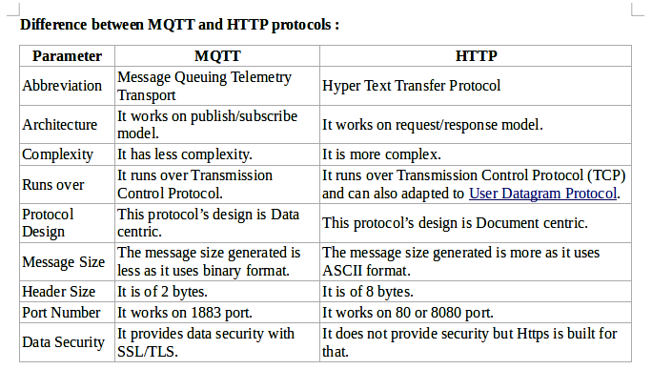

Slide 19
How MQTT-SN is different from MQTT?
MQTT-SN is designed to be as close as possible to MQTT, but is adapted to the particular behavior of wireless communication network such as low bandwidth, high link failures, short message length etc. Second, MQTT-SN is optimized for the implementation on low cost, battery-operated devices with limited processing and storage resources. Third, MQTT-SN needs a bridge to translate MQTT-SN messages into MQTT messages.
Compared to MQTT, MQTT-SN is characterized by following differences –
1) MQTT-SN supports topic ID instead of topic name. First client sends a registration request with topic name and topic ID (2 octets) to the broker. After the registration is accepted, client uses topic ID to refer the topic name. This saves media bandwidth and device memory – it is quite expensive to keep and send topic names like home/livingroom/socket2/meter in memory for each publish message.
2) The Topic name to topic ID can be preconfigured in MQTT-SN gateway, so that even registration message can be skipped before publish.
3) A discovery procedure helps clients without a pre-configured server/gateway’s address to discover the actual network address of an operating server/gateway. Multiple gateways may be present at the same time within a single wireless network and can co-operate in a load-sharing or stand-by mode.
4) The Clients connect to the broker through a gateway device, which resides within the sensor network and connects to the broker.

Slide 20
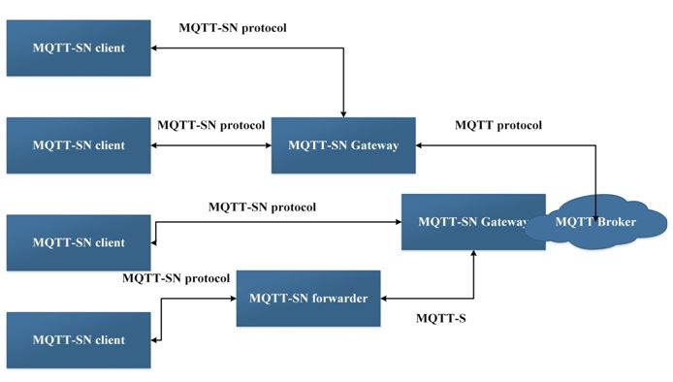

Slide 21
MQTT architecture
There are three kinds of MQTT-SN components – MQTT-SN clients, MQTT-SN gateways (GW) and MQTT-SN forwarders.
MQTT-SN clients connect themselves to a MQTT server via a MQTT-SN GW using the MQTT-SN protocol.
A MQTT-SN GW may or may not be integrated with a MQTT server.
In case of a stand-alone GW, the MQTT protocol is used between the MQTT server and the MQTT-SN GW.
Its main function is the translation between MQTT and MQTT-SN. MQTT-SN clients can also access a GW via a forwarder in case the GW is not directly attached to their network.
The forwarder simply encapsulates the MQTT-SN frames it receives on the wireless side and forwards them unchanged to the GW. In the opposite direction, it releases the frames it receives from the gateway and sends them to the clients, unchanged too.

Slide 22
There are two types of Gateways depending on how a Gateway performs the protocol translation between MQTT and MQTT-SN:
1) Transparent Gateway – For each MQTT-SN client, transparent gateway will form an individual MQTT connection to the MQTT broker.
2) Aggregating Gateway – In this, for all MQTT-SN clients, the Aggregating gateway will form only one MQTT connection to the MQTT broker. The advantage of using aggregating gateway is shown where WSN network has large number of sensor nodes because it helps in reducing the number of MQTT connections that broker has to create with individual client.

Slide 23
MQTT protocol distinct features
1) Gateway Advertisement and Discovery – A gateway continuously advertises itself by sending an ADVERTISE & GWINFO message to all devices that are part of the network. The client discovers the gateway by the Gateway unique ID. A client maintains the list of all active gateways with the network address & UID.
2) Client’s Connection Setup – An MQTT-SN client needs to setup a connection to a GW before it can exchange information with that GW.
3) Procedure for updating the will data – The client can update the previously registered Will topic and Will message at any time by sending the WILLTOPICUPD or WILLMSGUPD message.

Slide 24
MQTT protocol distinct features
4) Topic Name Registration Procedure – Because of the limited bandwidth and small payload, a registration procedure is involved. The client first sends the REGISTER message with the topic name to the gateway then if GW accepts the registration, it assigns the topic ID on that topic name and acknowledge it with the REGACK message. In that way, if client sends any message to that topic, it will not use the long topic name again, it will use only the assigned 2 bytes topic ID.
5) Client Disconnect – A client sends a DISCONNECT message to the GW to indicate that it is about to close its connection. After this point, the client is then required to establish a new connection with the GW before it can exchange information with that GW again.
6) Support of Sleeping Client – The broker or server remains aware of the sleeping clients and buffer the message 0020 to deliver them when they wake up.

Slide 25
Constrained Application Protocol (aka CoAP) is a specialized web transfer protocol for use with constrained nodes (low power sensors and actuators) and constrained networks (low power, lossy network). It enables those nodes to be able to talk with other constrained nodes over Internet. The protocol is specifically designed for M2M ( machine to machine) applications such as smart energy, home automation and many Industrial applications.
CoAP protocol is necessary because traditional protocols such as TCP/IP are considered “too heavy” for IoT applications that involves constrained devices. CoAP protocol runs on devices that support UDP protocol. In UDP protocol, client and server communicate through connectionless datagrams.

Slide 26
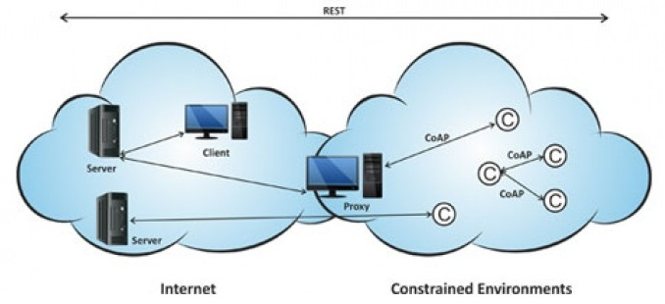

Slide 27
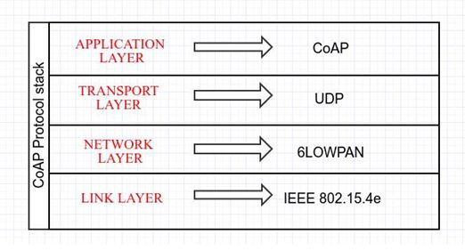

Slide 28
The CoAP protocol has the following features
1) It provides M2M communication in constrained environment.
2) It provides security of data by datagram transportation layer security (DTLS).
3) Asynchronous message exchange.
4) Low header overhead and parsing complexity
5) URI and content type support
6) UDP binding with optional reliability supporting unicast and multicast requests.

Slide 29
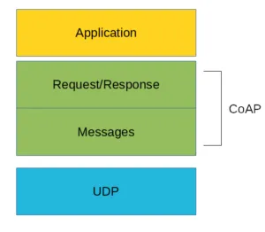

Slide 30
There are two different layers that make CoAp protocol: Messages and Request/Response. The Messages layer deals with UDP and with asynchronous messages. The Request/Response layer manages request/response interaction based on request/response messages.
CoAP supports four different message types:
Confirmable
Non-confirmable
Acknowledgment
Reset
Before going deeper into the CoAp protocol, structure is useful to define some terms
Endpoint: An entity that participates in the CoAP protocol. Usually, an Endpoint is identified with a host
Sender: The entity that sends a message
Recipient: The destination of a message
Client: The entity that sends a request and the destination of the response Server: The entity that receives a request from a client and sends back a response to the client

Slide 31
CoAP Messages Model
This is the lowest layer of CoAP. This layer deals with UDP exchanging messages between endpoints. Each CoAP message has a unique ID; this is useful to detect message duplicates. A CoAP message is built by these parts:
A binary header
A compact options
Payload
As said before, the CoAP protocol uses two kinds of messages:
Confirmable message
Non-confirmable message
A confirmable message is a reliable message. When exchanging messages between two endpoints, these messages can be reliable. In CoAP, a reliable message is obtained using a Confirmable message (CON). Using this kind of message, the client can be sure that the message will arrive at the server. A Confirmable message is sent again and again until the other party sends an acknowledge message (ACK). The ACK message contains the same ID of the confirmable message (CON).

Slide 32
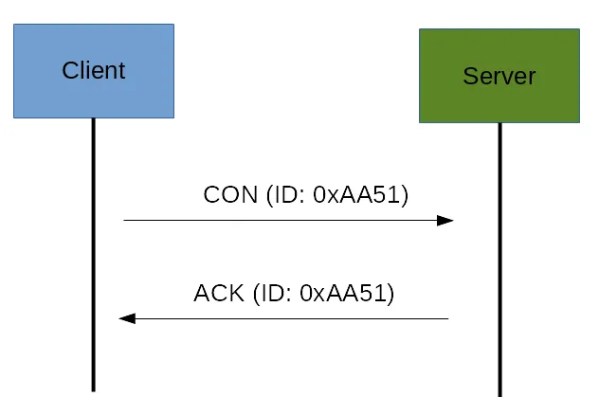

Slide 33
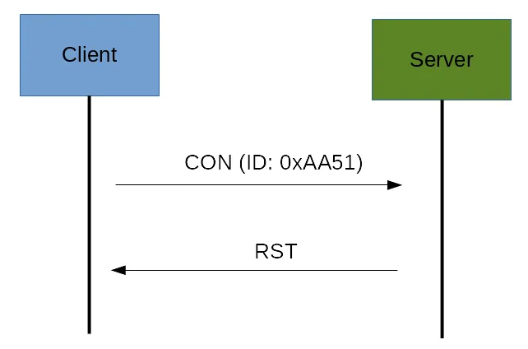
If the server has troubles managing the incoming request, it can send back a Rest message (RST) instead of the Acknowledge message (ACK):

Slide 34
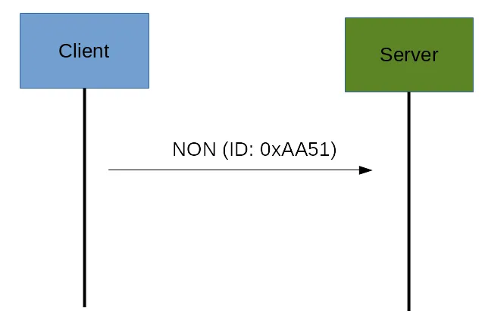
The other message category is the Non-confirmable (NON) messages. These are messages that don’t require an Acknowledge by the server. They are unreliable messages or in other words messages that do not contain critical information that must be delivered to the server. To this category belongs messages that contain values read from sensors.
Even if these messages are unreliable, they have a unique ID.

Slide 35
CoAp Request/Response Model
The CoAP Request/Response is the second layer in the CoAP abstraction layer. The request is sent using a Confirmable (CON) or Non-Confirmable (NON) message. There are several scenarios depending on if the server can answer immediately to the client request or the answer if not available.
If the server can answer immediately to the client request, then if the request is carried using a Confirmable message (CON), the server sends back to the client an Acknowledge message containing the response or the error code:

Slide 36
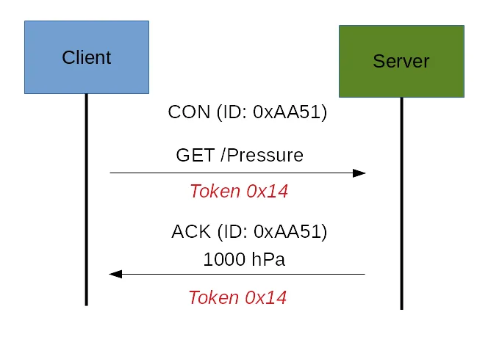

Slide 37
If the server can’t answer to the request coming from the client immediately, then it sends an Acknowledge message with an empty response. As soon as the response is available, then the server sends a new Confirmable message to the client containing the response. At this point, the client sends back an Acknowledge message:

Slide 38
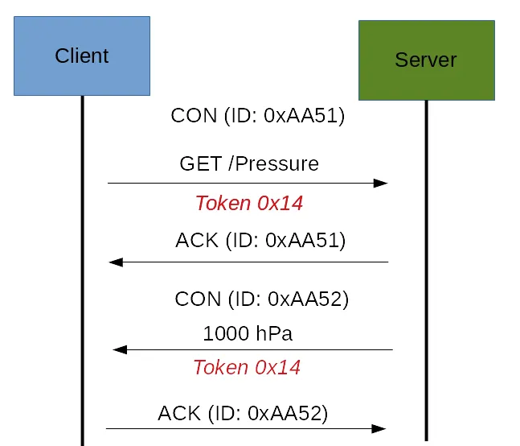

Slide 39
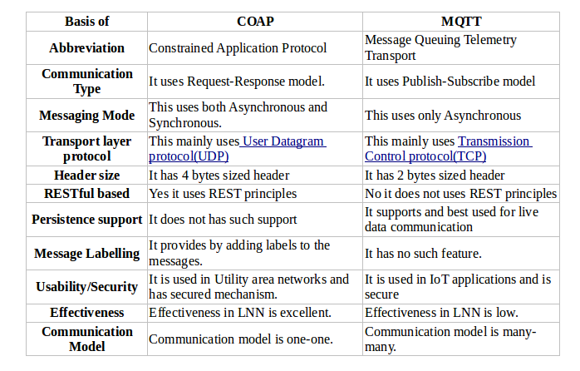

Slide 40
Simple (or Streaming) Text Oriented Message Protocol (STOMP)
STOMP is text based protocol.
It is developed to work with message oriented middleware.
It uses interoperable wire format.
This format enables clients to communicate with message broker to enable easy and widespread messaging interoperability. This communication is irrespective of languages, platforms and brokers used in the architecture.
STOMP protocol provides message header with properties and frame body like AMQP.
It is a simple and light weight with wide range of language bindings. Some transactional semantics are also provided by it.

Slide 41
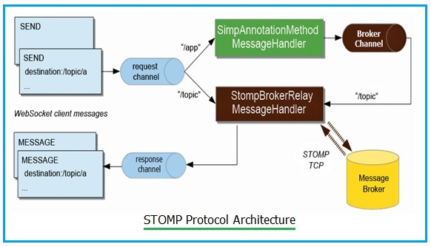

Slide 42
Like other broker based protocols, STOMP specifies publish-subscribe mechanism. Here clients subscribe to topics (compare to a path in HTTP) and they will be notified whenever messages have been sent to that particular topic by broker.
STOMP does not require use of queues and topics. Instead, it uses "SEND" semantic with "destination" string.
STOMP is a bi-directional protocol which uses textual headers similar to HTTP.
The broker must map "destination" string onto something which it understands internally e.g. topic, queue or exchange.
Consumers subscribe to these destinations.
Different brokers can support different flavors of destinations as they are not mandatory in the specifications. Hence care need to be taken while porting code between different brokers as it is not straightforward.

Slide 43
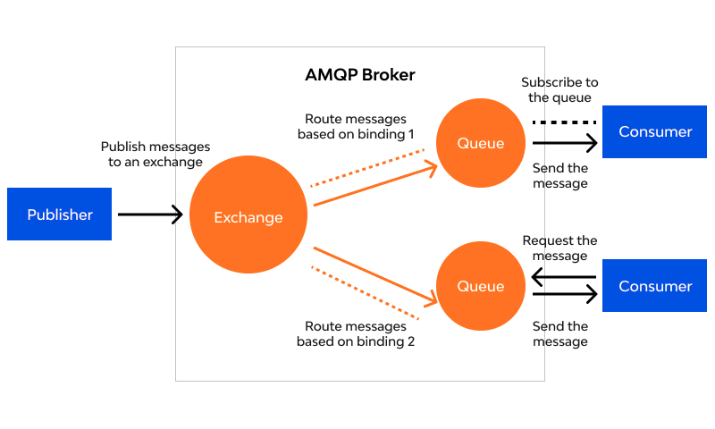
Advanced Message Queuing Protocol (AMQP)

Slide 44
AMQP Terminology
Broker (or server) plays a crucial role in AMQP protocol enablement. It is responsible for connection building that ensure better data routing and queuing at the client-side.
The job of queues generation and message acknowledgement is taken care of by consumer.
Redirection of data taken from exchanges and its placement in queues is taken care of by producer.

Slide 45
Components of AMQP
Exchanges (and their classification)
Exchange handles the responsibility of fetching messages and placing them carefully in the right queue. Its 4 categories are: Fanout, Headers, Topic, and Direct. To detail you on it further, it is an indispensable component of the broker.
Channel
Channel refers to a multiplexed virtual connection among AMQP peers, which is built inside an existing connection.
Message Queue
It is an identified entity that helps link messages with their resources or point of origin.
Binding
Bindings denote a set of predefined instructions related to queues as well as exchanges. It administers the sending of message and their delivery.
Virtual Hosts
vhost is a platform offering the segregation facility inside the broker. Based upon users and their access rights, there could be multiple vhost functional at a time.

